Slide 1
Session 3: Masculinity & Violence

Slide 2
Session 3: Overview
Roadmap for Today!
Welcome (5min)
Framing The Session(5min)
Aims & Objectives(5min)
Activity 1: Breaking Point (30min)
Activity 2: ‘What is rape culture?’ (30min)
Reflections

Slide 3
" The Violence I should Underscore comes in different forms. It is direct and Indirect. It is against Children, against women, against other men and against the self "
Kopano Ratele

Slide 4
Introduction
Framing the session
In the last session we explored - beliefs, how they can be limiting and how to think about them critically.
We also briefly touched on the link between gender norms, and their link to violence.
In this session, we examine this link in more depth, as we look at the connection between masculine norms and violence to ourselves and to others.

Slide 5
Introduction
According to the world health organization, violence entails the intentional use of physical force or power, threatened or actual, that either results in or has a high likelihood of resulting in injury, death, psychological harm, maldevelopment or deprivation. (World Health Organization, 2002)
Violence can be self-directed, directed against others or structural in nature. High levels of violence and crime in regions such as South Africa are often the symptoms of underlying social, economic, and political challenges such as social inequality, rapid urbanisation, poverty, unemployment, and institutional limitations. (Safety and Violence Initiative, 2019)

Slide 6
Introduction
In this regard, South Africa’s history of colonialism, and apartheid means that violence is something we must contend with daily. From the spatial inequality, degradation, and material deprivation that characterize township life, to domestic abuse, gang violence or sexual assault; South Africa has a lot of work to do to lessen the occurrence of violence and its impact. To do this well, it is important to understand the intersectional causes violence in society and its gendered nature.

Slide 7
Introduction
Over the years, sociologist have found that violence – murder, rape, intimate partner violence or gang related committed against women, children, or men, is predominately committed by men (Barker, 2018). Globally, men are also more likely to suffer from addiction, suicide, or be the victim of homicide. (Clowes, 2013) (Jewkes)
While it is tempting to explain the above findings, through biology and its assumption that men are naturally more violent; this is too simplistic.
Violence involves complex web of intersecting elements, including social conditions, life circumstances, childhood experiences, political economy, gender attitudes, and more. (Barker, 2018)

Slide 8
Introduction
In terms of gender attitudes, it has been found that dominate beliefs about the performance of manhood and what it means to be man are the some of the driving forces behind the violence described above. (Safety and Violence Initiative, 2019).
In short society has entrenched the idea that sexual violence, and the violence committed by men, is a normal and inevitable part of life. From childhood, boys are often taught and expected to act in ways characterized by high levels of aggression, withdrawal, sexual activity denial-avoidance and low concern for the needs of others. (Hooks, 2004)

Slide 9
Aims & Objectives
Understand Gendered Roles and their connection to Violence
Explore how this plays out at a personal level
Unpack ‘ rape culture’, and challenge the beliefs which perpetuate it

Slide 10
Activity 1: My Breaking Point
20 Minute
Group Discussion: Participants must reflect on their past and think about a moment in their life when they became violent.
Participants will then share about a point in their life where they lost themselves and became violent.
What caused it?
What role if any, did the need to prove your manhood play a factor?
Was there another alternative to violence at the time?

Slide 11
Activity 2: ‘Agree | Disagree?’
Myth or Fact : 30 minutes
Task: Participants should stand in a single line as the facilitator reads out a statement/belief . Participants will then take two steps to the left if they agree, two steps two the right if they disagree or standstill if they are in between/unsure.
Depending on the time and what works best for the group, participants must critically reflect on how said belief might be harmful. They can either discuss after each point or after all the statements have been read.

Slide 12
Activity 2: ‘Agree | Disagree?’
Statements
Buying a woman, a lot of expensive drinks at the club means that they should go home with you.
Someone accepting an invite to your house, late at night when you are alone means that they want to have sex with you.
Anger Causes violence
A real man can control his women.
Jealousy is a sign of love
Sometimes women put themselves in dangerous situations where they can be sexually assaulted.
Women make false allegations all the time.
Sometimes women play hard-to-get. So when they say no it mean’s keep trying
Women need to dress respectable to avoid being assaulted.
Men are naturally violent

Slide 13
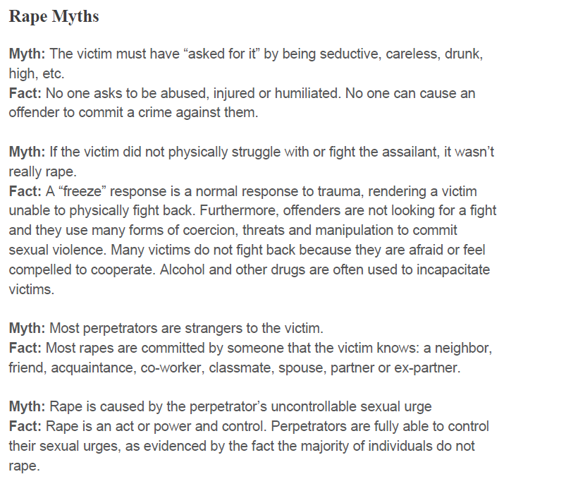

Slide 14
What is Rape Culture?’
What is Rape Culture?
Rape culture is the social environment that allows sexual violence to be normalized and justified, fueled by the persistent gender inequalities and attitudes about gender and sexuality.
It persists through language, attitudes and beliefs which objectify women’ and blames them for being victims of abuse.
Rape-affirming beliefs are embedded in our language: “She was dressed like a slut. She was asking for it,”
It is part of popular song lyrics: “I know you want it.”
It is normalized by objectifying women and calling them names in pop culture and media.

Slide 15
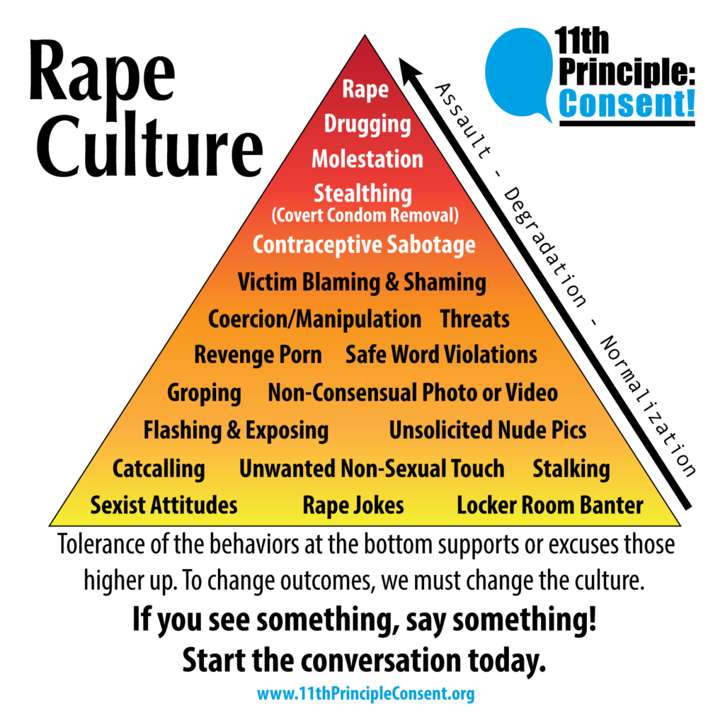

Slide 16
What is Rape Culture?’
You have the power to choose to leave behind language and lyrics that blame victims, objectify women and excuse sexual harassment. What a woman is wearing, what and how much she had to drink, and where she was at a certain time, is not an invitation to rape her.

Slide 17
Reflections and closing

Slide 18
Thank you!

